Slide 1

Ellensburg School District
Replacement Educational Programs and Operation Levy
& Technology Levy
VOTE February 8, 2022

Slide 2
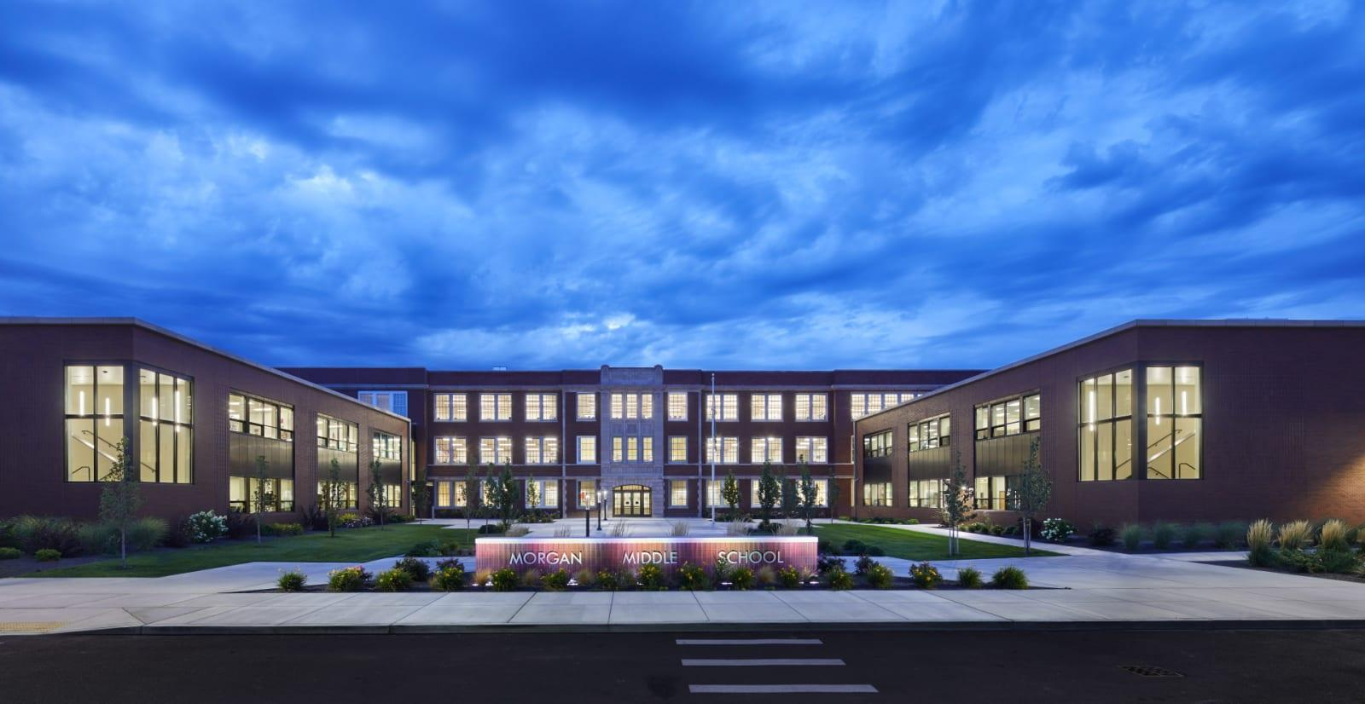

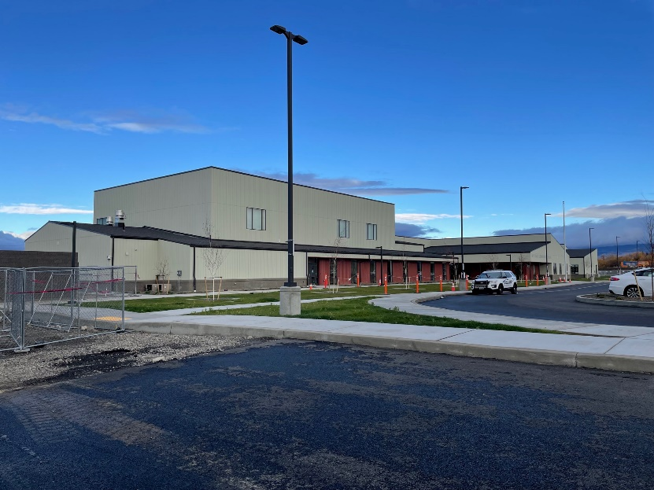
Bonds are for Building
Bonds build and renovate schools
  Morgan Middle School remodel
  New Mt. Stuart Elementary
  New Ida Nason Aronica Elementary
  Lincoln Elementary remodel

Slide 3
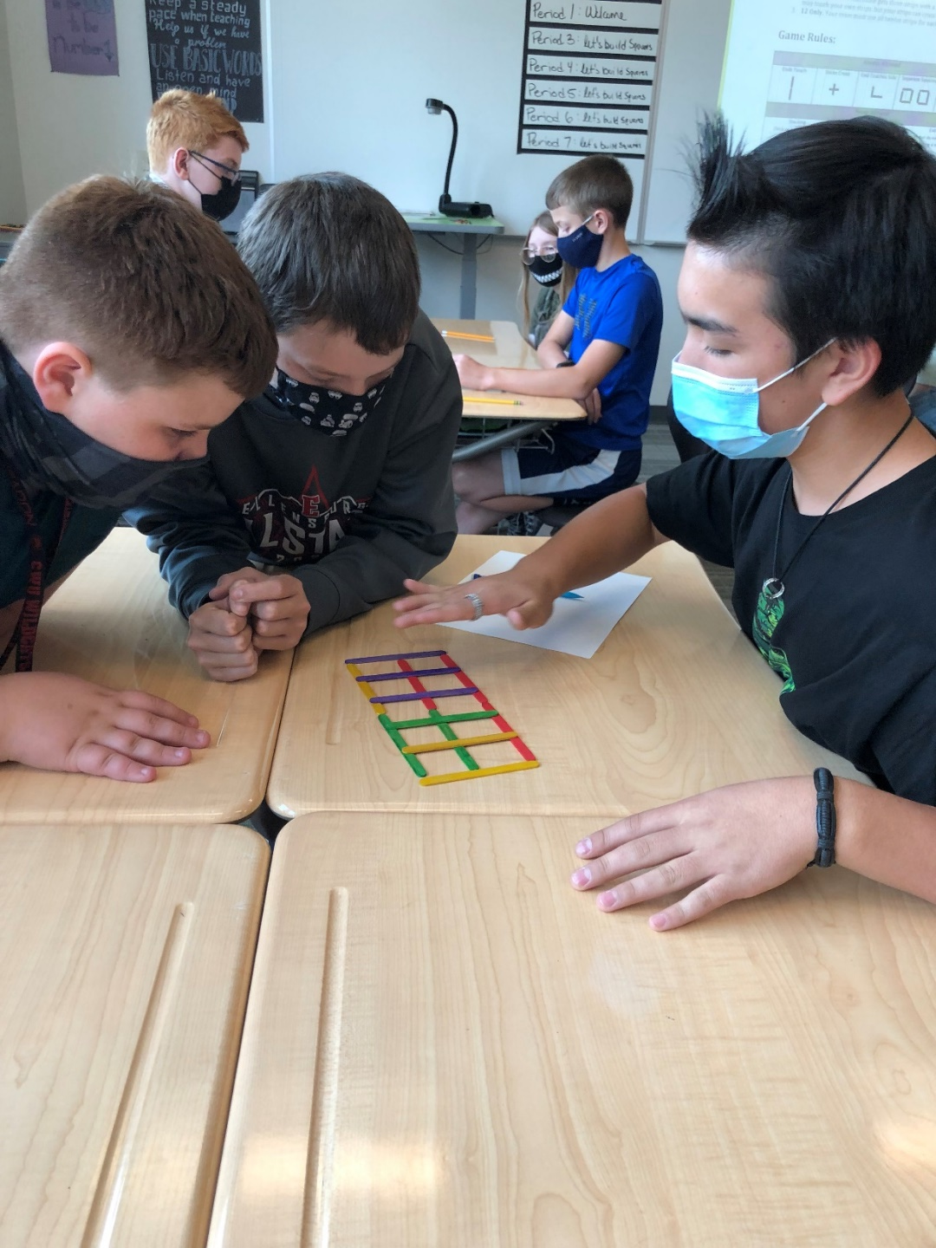
Levies are for Learning
A Levy is a local property tax passed by the voters of a school district that generates revenue to fund programs and services that the state does not fund or fully fund as part of basic education.
Because the funding provided by the state does not cover the actual costs to operate a school district, districts often use levy funds to hire additional staff, or for student programming and services that are underfunded or not funded by the state.

Slide 4
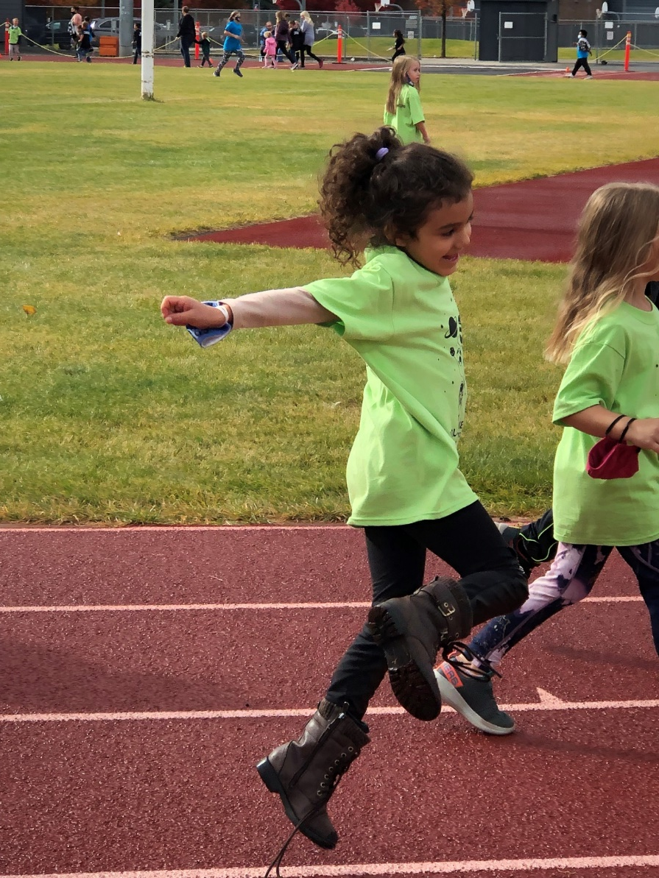
How Are Ellensburg Schools Funded?
Ellensburg schools are primarily funded through an allocation by the State, with Federal dollars and local levy money making up the difference. State money covers about 75 percent of the cost of running our schools. About 12 percent is Federal money, primarily grants that must be spent in specific ways on targeted programs.
Ten percent of the ESD operating budget comes from local levy money.

Slide 5
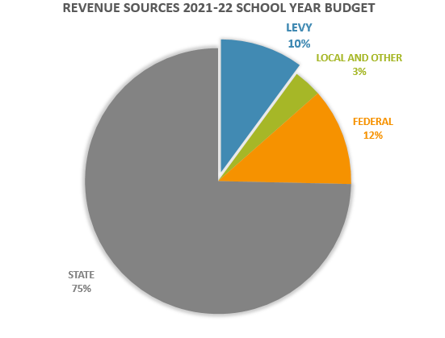

Slide 6

Cost of the EPO Levy
The estimated tax rate is $2.50 per $1000 of assessed value, starting in 2023.
Assessed home value ÷ 1,000 x Local Levy Rate
$300,000 ÷ 1000 x $2.50 = $750

Slide 7
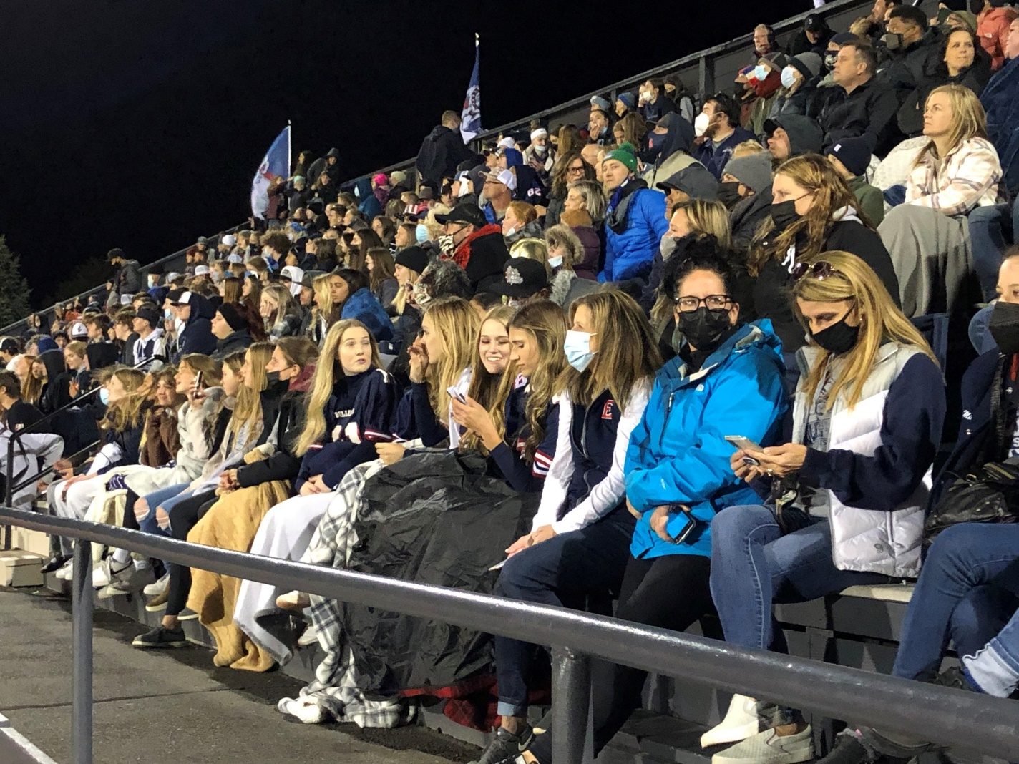
What the EPO Levy Provides
EPO Levy provides approximately 10 percent of current ESD revenue.
Levy failure would result in significant reductions in staff, programs and services for students.

Slide 8

Teaching and Learning
Building budgets and extended learning
  5th Grade Camp
  Winter School
  District swimming program
Curriculum and professional development
  Ensures our students have the resources they
  need and that our teachers are continuing
  to learn and grow in their expertise.
Special Education Program costs
Substitute costs

Slide 9
Health and Safety
Security
Districtwide drug & alcohol/mental health/suicide prevention programs.
Long term staffing needs for both classified and certified personnel, which include:
  Nurses
  Counselors
  Mental health specialists
  Family liaisons

Slide 10
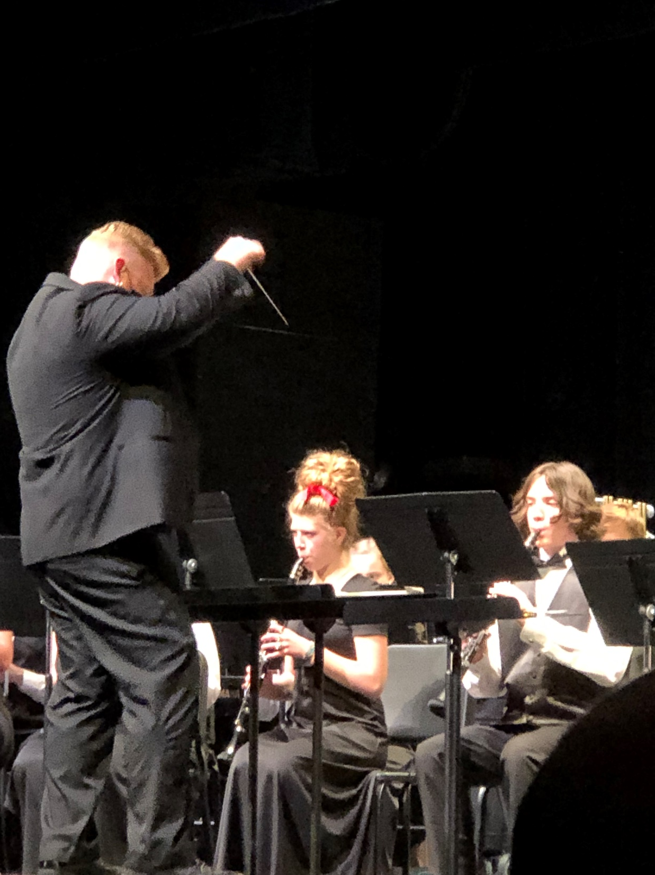

Extra-Curricular Activities
& Programs
Orchestra
Music
Choir
Band
All Boys and Girls sports, including Football, Soccer, Volleyball, Swim, Cross Country, Basketball, Wrestling, Bowling, Baseball, Softball, Track, Golf, and Cheer.
Coaches and Extra-Curricular Advisors

Slide 11
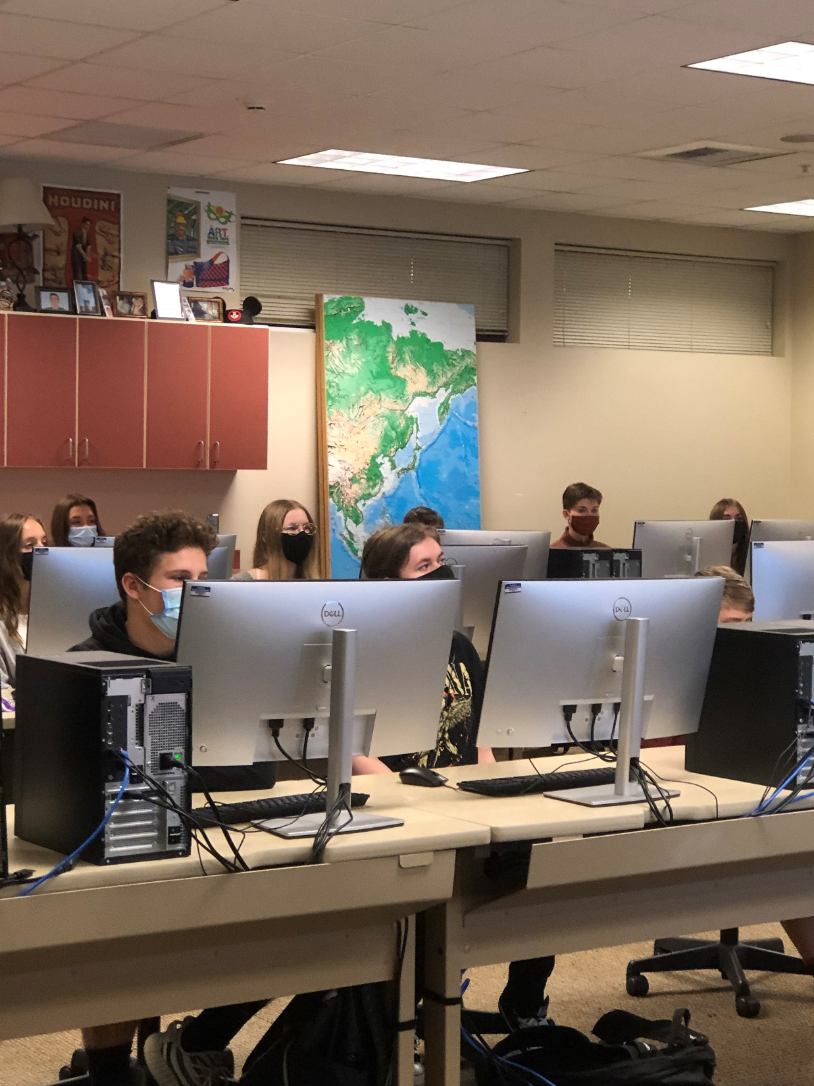
Technology Levy
The Technology Levy, which will appear as a separate measure on the ballot, will allow the District to continue with the current model of funding and replacement of necessary instructional technology improvements. With the last Technology Levy, which expires in 2022, ESD was able to meet the goals of:
Equipping every student in grades 5-12 with a device,
Upgrading the District network and WiFi,
Placing multiple laptop carts, projectors, document cameras and desktop computers in our schools.

Slide 12

Cost Information for the Technology Levy
This levy would authorize an excess tax levy to be made annually for six years commencing in 2022 for collection in the years 2023 through 2028 in the aggregate total amount of $7,600,000 for the District’s Capital Projects Fund.
This levy would support the modernization and remodeling of school facilities by making certain instructional technology improvements.

Slide 13

The proposed Technology Levy will extend from 2022 to 2028, providing:
Additions and replacements to our current model of funding
One full time Educational Technology position
Additional necessary funds for Ida Nason Aronica technology, including yearly purchases
Digital signs for schools, including external reader boards
Additional money for curriculum-specific platforms
Schoology and related Learning Management Systems
Additional software/hardware

Slide 14

Community Expectations
ESD told local voters that combined school bonds and levies would not :
Exceed $4.50 per $1,000 of assessed value.
If passed, these levies will result an estimated total of $4.20-$4.30 per $1,000 of assessed value, which includes the soon-retiring Ellensburg High School bond, the bond that remodeled Morgan Middle School and the bond monies that are currently building and renovating our elementary schools.

Slide 15
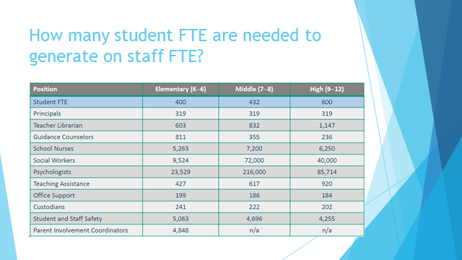

Slide 16
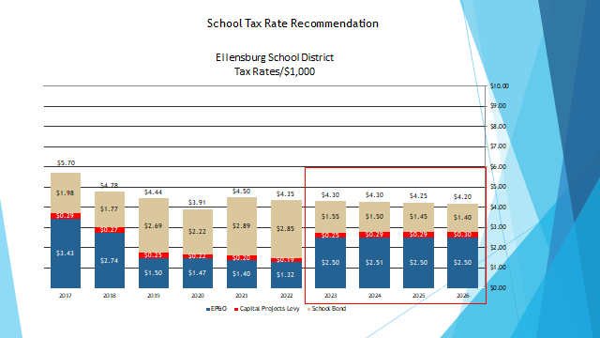

Slide 17
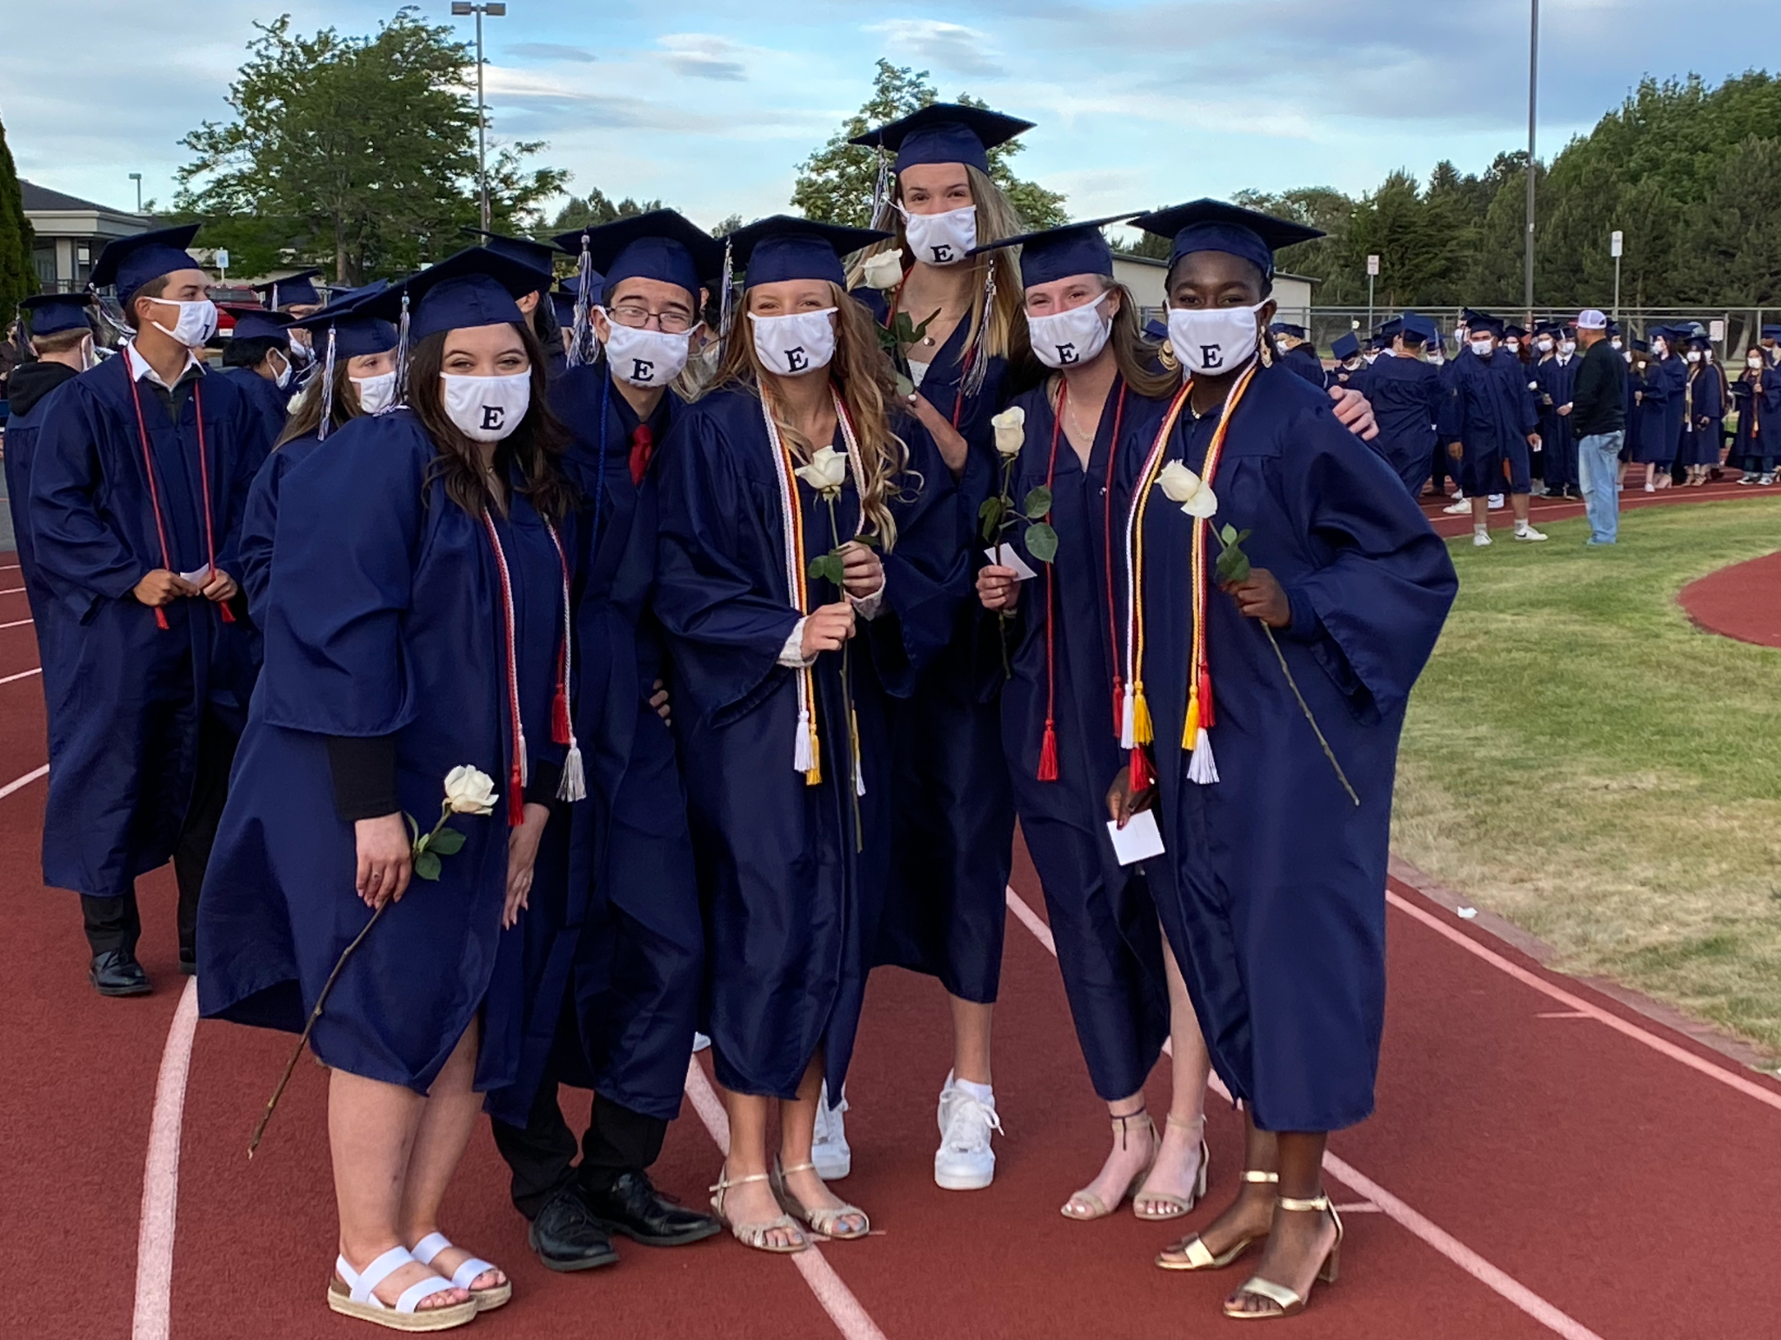
Questions?
Please VOTE by
February 8, 2022

